Slide 1

SOC 218
Anthropology
Lecture 8-chapters 18 & 20
These slides contain two short-answer essay questions. These items appear in red

Slide 2
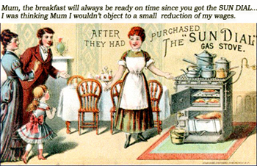
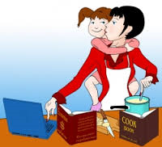

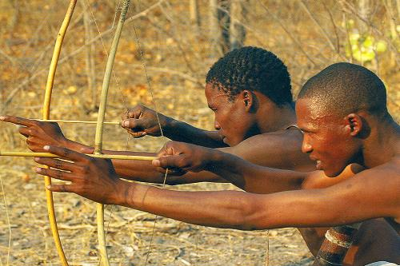
Domestic-Public Dichotomy
Gender Roles
  Women
    Childcare
    Gathering
  Men
    Hunting
    Tool making
Gender Stratification
  Women in the workplace
    (see link)
  Feminization of poverty
    (see link)
  Societal happiness
    (see link)
Short-answer essay 10
  We would be better off if more women worked outside the home, agree or disagree?

Slide 3
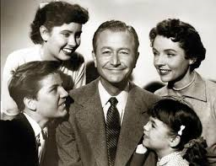
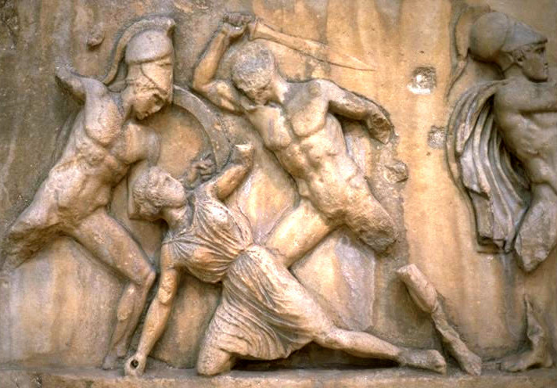
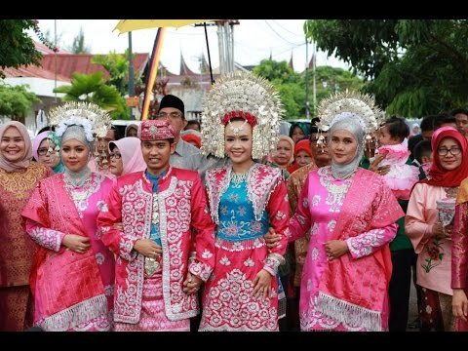
Patrilineal-Patrilocal Complex
Patrilineal descent
  Surnames (see link)
Patriarchy
  Yanomami (see link)
  Feminism and Islam (see link)
    Violence intervention (see link)
Short-answer essay “bonus”: what cultural barriers might the UN face in attempting to change attitudes about domestic violence?
Matrilineal-Matrilocal Societies
  Minangkabau matriarchy (see link)

Slide 4

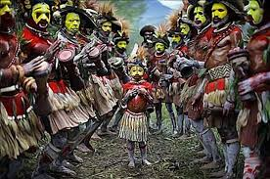
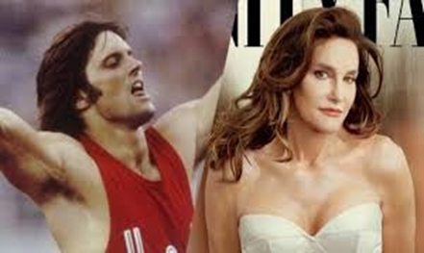

Gender, Sexuality, Cultural Variation
Sexual orientation
  3-4% of the population is estimated to be gay/non-hetero
    Higher percent admit to a same-sex experience or attraction
  Legality of sexual behavior
    (see link)
  Ritualized sexual behavior
    Etoro of Papu New Guinea
Trans people
  Intersex
    Chromosomal differences (see link)
  Transvestites
    Brazil’s third gender (see link)

Slide 5

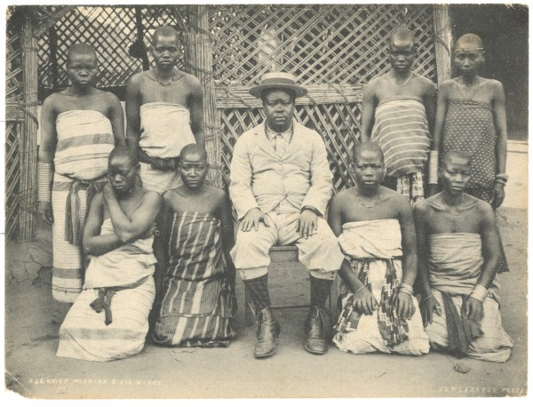
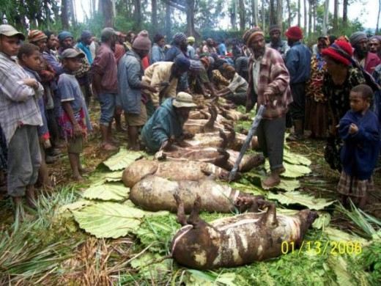
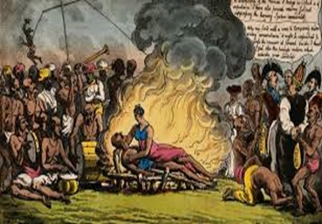
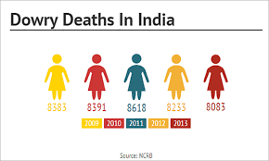
Cultural Variation in Marriage
  Romantic love in marriage
    A more recent and Western phenomenon
      Linked with egalitarian relationships between men and women (see link)
      Off-spring and pair-bonding (see link)
  Polygyny
    Wives and status
  Lobola—or bridewealth
    Daughter is lost labor
  Dowry or husband price
    Daughters are costs/burdens
      Women Maps (see link)
      Sati in India
    Sororate and Levirate

Slide 6
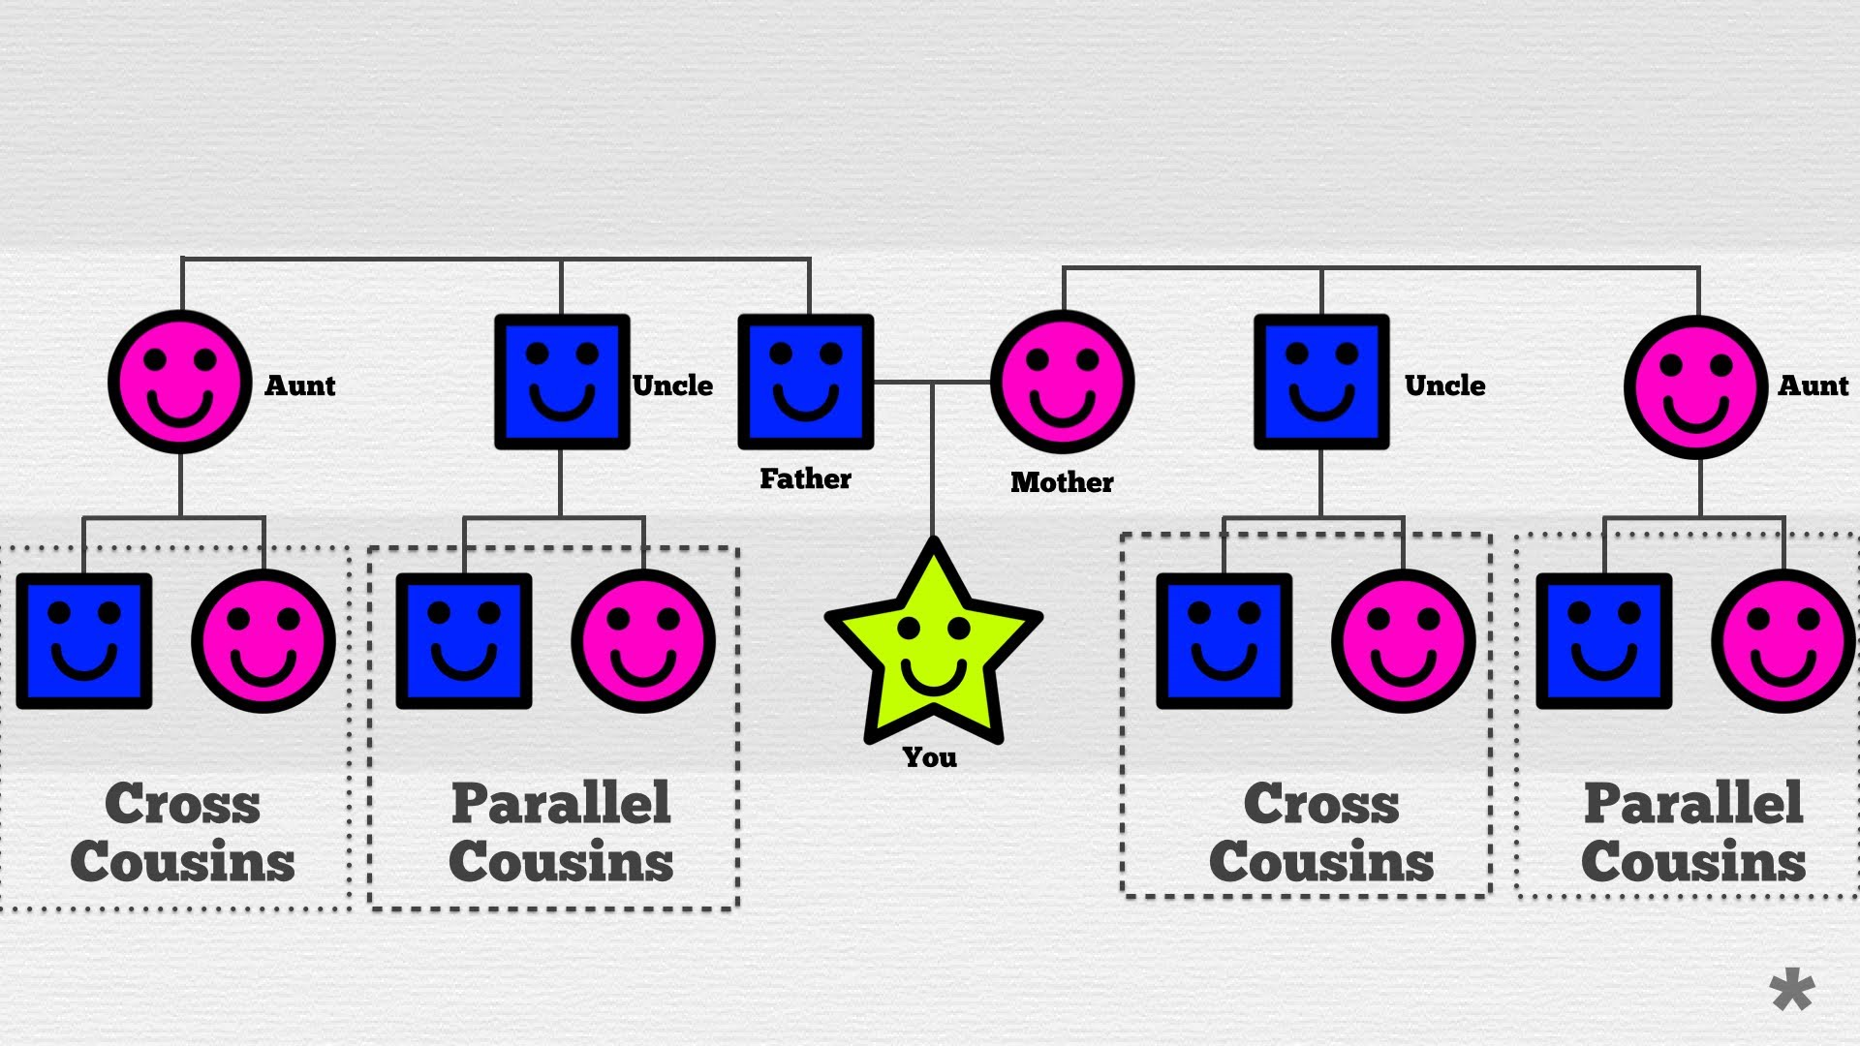
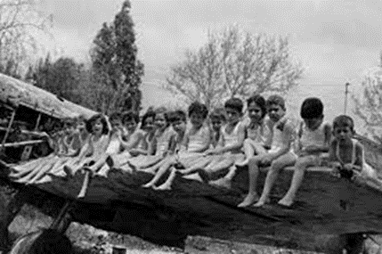
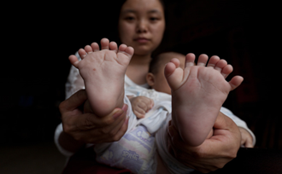
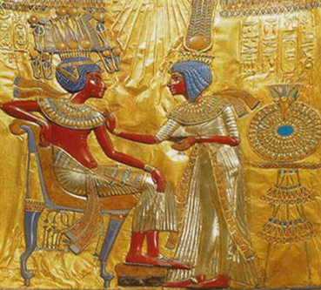
Cultural Variation in Mate Selection
Incest Avoidance
  Parallel vs. Cross Cousins
    Marriage and the Yanomami (see link)
  Instinctive horror
    Yet, taboo exists; may not be instinctive reaction
  Early contact
    Westermarck effect
      Israeli kibbutz
Social Castes
  India, formally abolished in 1945, still practiced informally
    Inbreeding and birth defects
    Royal Endogamy in Ancient Egypt and elsewhere
      Sibling marriage among royalty and commoners
        19--37%
    Exogamy
      Forge political alliances
      e.g. Queen Elizabeth I

